Slide 1
Fit for Mission
St Columba Centre
18 April 2015

Slide 2
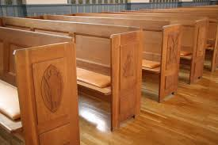
Fit for Mission Bingo- What makes up a Parish
Liturgy and Sacraments
Finance Committees
Parish Councils
Social Justice Animators
St Vincent de Paul Society
Caring Groups
Youth Group
Food Bank
Parish School
Kindergarten
Home Groups
Pastoral Council
Seniors Group
Where does Fit for Mission fit in to Parish Structures?
Its about something new, its about moving past this…….

Slide 3
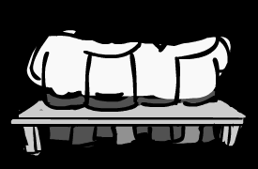
Fit for Mission Bingo- What is Fit for Mission?
Fit for Mission is about serving people in which we do not know, nor expect anything back from.
Its about sharing our resources
Its about real relationships

Slide 4
Lets Play…. Fit for Mission Bingo
Parish A has arranged for all those who serve as readers to do a workshop on how to read scripture. | Community D has arranged 40 people on a roster to pick up the elderly in their community to bring them to Mass on Sunday | Community I invited a member of their community to talk about their working with young people about drug and alcohol abuse. Hearing the story the Parish got there youth group involved and have arranged a programme for their parish families to come together to talk about these issues.
Parish B has arranged a flyer drop in their community asking Catholics who are not attending Mass to come and join them for a social event at the Parish Hall. | Parish E after talking to the local citizens advice there was a need to get young mums together. The parish opened up their hall, got some donated toys and advertised a play group. Mum and some Dads come along each week. Some parishioners who cannot come along to help out doing some baking and send it along. | Parish H – continues to collect non perishable food for the St Vincent de Paul Society, they raise funds for the sisters working the Pacific and support Caring Sunday and the Caritas Lent Appeal.
Parish C the youth group has always visited a rest home once a month as an outreach. They heard a speaker from Pax Christi and learnt about the people of West Papua and the oppression they face. They wrote letters to every MP and made prayer cards for the parish highlighting their cause. | Parish F suggested to run a cup of tea after 10am Mass so parishioners can get to know each other. | Community G got parishioners to get gardening and grow seeds to supplement fresh veggies in food parcels. They then got on the environmental bandwagon and organised a walk not drive campaign. they invited the local and Anglicans and Methodists parishes to join them.

Slide 5
The Results are in
Parish/ Community
Where do we sit on the Matrix
Parish A –
Parish B-
Parish C
Community D
Parish E
Parish F
Community I
Parish H
Community G
Liturgical
Evangelization
Fit for Mission
Pastoral
Pastroal
Pastroal
Traditional mission of the church
Fit for Mission

Slide 6
Talk to your group about your results
Reflection and Question
With one hand charity. With one hand justice

Slide 7
Community mapping

Slide 8
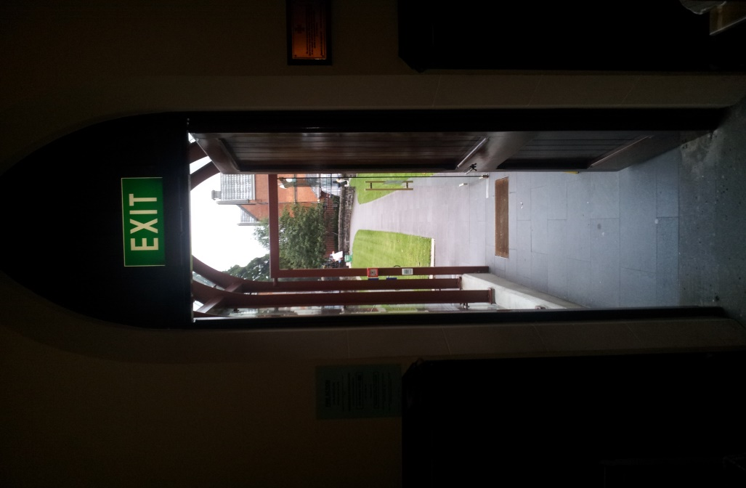
Welcome to the Parish of Our Lady of the Waitamata
Parish Facts
Mass Count 350
Parish Primary School
Hall
One Priest
Retired Community of Sisters
St Vincent de Paul Group
Parish Council
Finance Committee
Youth Group

Slide 9
How Can this Parish develop a Fit For Mission Plan?
A small group has been established to set up a plan – volunteers and shoulder tapping
Discernment - Asking the questions and prayer
What resources do we have to share?
People
Hall
Finances

Slide 10
Next Step – Engage in the Community
GET TALKING
Talk to people who work in social services in the parish
Ask the schools in your area
Talk to the local Anglican Vicar, the Methodist Pastor the Imam and the Mosque
Liaise with secular and faith based
social service providers

Slide 11
The plan of Attack
The working group has met and decided that the best thing to look at is a home work club.
Why????????
It was need that was noted by members of the wider community, no one else was doing it.
It could help kids at the local state school and parish who need extra help and parents could not afford extra tutoring.
The resources of the Parish could be used without a huge strain.
Ideas presented to Parish Council and at Mass.

Slide 12
Who, What, Where and Why????
It’s the nuts and bolts
Not everyone can be directly involved but some people bake for afternoon tea
Others offer donations for resources
The parish pray for the group
Shared Leadership
Team involves lots of people from youth- retired
People are kept up to date through social media, reports at Mass, parish newsletter

Slide 13
Things to think about
Child Protection
Police Checks
OSH
Sustainability
Group vs Individual Ministry
Safety Protocols – what happens if?

Slide 14
Its all about Relationship
Six months down the track
35 kids and their families are coming twice a week.
In building relationships with parents the group have discovered that some parents are struggling with their own literacy and numeracy – talk of some help with them.
There have been some challenges but the leadership group have settled the issues.

Slide 15
With one hand charity the other hand justice
The parish have become more aware of the plight of the families in their community.
They start talking to local MPs and Council members to address the plight of these families they know.
Members of the parish attend Child Poverty Action Group Meetings and the J and P Comm at the Diocese.
They start to see change in their community

Slide 16
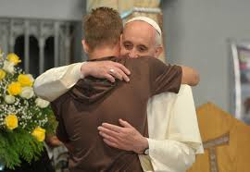
Inspiration
A priest who has a full time job in Rome also volunteered at a local soup kitchen
And he said….
“I prefer a church which is bruised, hurting and dirty because it has been out on the streets…”

Slide 17
Now its time for you to think talk and act

